Slide 1
Abstract Data Type

Slide 2
What is Data Type
Two important things about data types
Defines a certain domain of values
Defines Operations allowed on those values
Example –
int type
-- Takes only integer values
-- Operations : addition, subtraction, multiplication, bitwise operations , etc

Slide 3
Abstract Data Types (ADT)
Abstraction :
The process of providing only the essentials and hiding the details is known as abstraction.
ADTs are like user defined data types which defines operations on values using functions without specifying what is there inside the function and how the operations are performed.

Slide 4
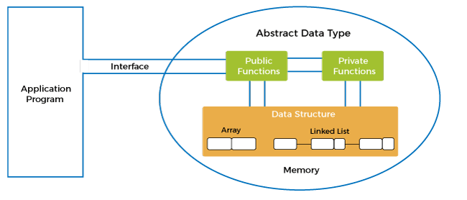

Slide 5
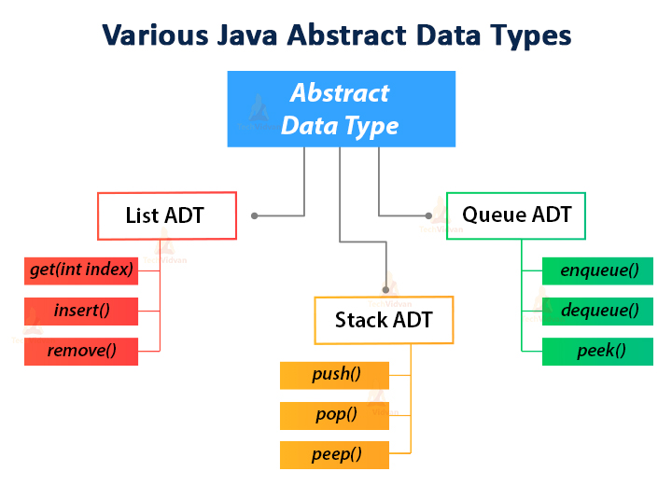

Slide 6
Example
Stack ADT
A stack consists of elements of same type arranged in a sequential order
Operations:
Push() - insert an element into the stack
Pop() – delete an element from the stack

Slide 7
Real time example smartphone
Specifications –
4 GB RAM
Snapdragon 2.2ghz processor
5 inch LCD screen
Dual camera
Android 8.0
Operations –
call(): We can call through the smartphone.
text(): We can text a message.
photo(): We can click a photo.
video(): We can also make a video.

Slide 8
class Smartphone
{
private:
int ramSize;
string processorName;
float screenSize;
int cameraCount;
string androidVersion;
public:
void call();
void text();
void photo();
void video();
}

Slide 9
Why ADT ?
The program which uses data structure is called a client program
It has access to the ADT i.e interface
The program which implements the data structure is known as the implementation
Advantages
Reduces complexity , easier to understand
Implementations of ADTs can be changed without requiring changes to the program that uses the ADTs

Slide 10
Thank you

